Slide 1
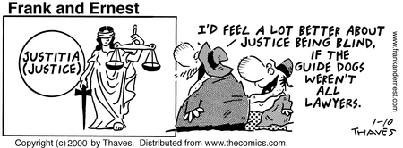
New Advisor Workshop
Amy Urbanek: University of Utah
Jerry Polinard: University of Texas Rio Grande Valley

Slide 2
Academic Preparation
Complete a Bachelors degree
Acquire a rigorous and balanced education
Choose a major you enjoy, and that motivates and challenges you
There is no “best” major
Really!

Slide 3
Develop Important Skills
No specific prerequisite classes are required
Oral Communication and Listening
Critical Thinking & Problem Solving
Research
Critical Reading
Task Organization/Management
Writing and Editing

Slide 4
Basic Areas of Knowledge
History – particularly US History
Political Science – particularly the US Constitution and the US political system
Ethics and Theories of Justice
Economics – Particularly Microeconomics
Human Behavior and Social Interactions
Diverse Cultures within and Beyond the US
Math
Ability to understand financial data

Slide 5
Extracurricular Activities
Activities or Jobs that Develop or Demonstrate:
Organizational Skills
Time Management
Leadership Abilities
Teamwork & Collaboration
Public Service &
Promotion of Justice
QUALITY is important, not necessarily Quantity!
Start with variety, then find a passion!
A long list of organizations with limited involvement is not impressive

Slide 6
Extracurricular Activities
CAUTION: extracurriculars, while important, will not compensate for poor grades

Slide 7
Assess Your Decision
Research the field
Information interviews
Shadowing
Sit in on law class
Observe trials
Read about the field
Network
Get to know attorneys before, during, and after law school
This will be critical to your success when you enter the job market
Don’t go to law school because you don’t know what else to do!
Make sure law is the right choice for you

Slide 8
Bimodal Distribution

Slide 9
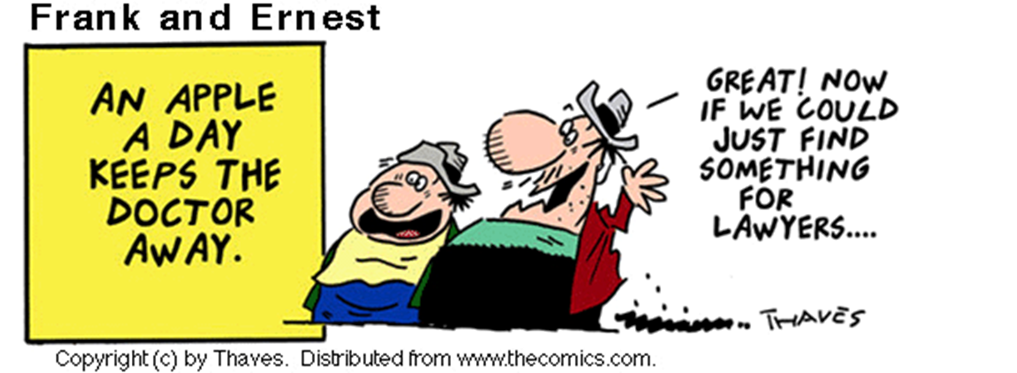

Slide 10
The Law School Application Pieces
Academic record
Law School Admission Test (LSAT)
Resume
Personal statement
Letters of recommendation
Holistic evaluation

Slide 11
Law School Admissions Test (LSAT)
Skills Based Test:
Logical Reasoning
Analytical Reasoning
Reading Comprehension
Writing Sample (not scored)
Scoring:
Range: 120-180
Main Competitive Range: High 150’s to mid 160’s
High 160’s and above are very good scores
173-174 usually 99th percentile

Slide 12
Law School Admissions Test (LSAT)
Registration and information www.LSAC.org
Fee for 2015-16: $175
Four test dates each year
June: Monday, 12:30 pm
October: Saturday, 8:30 am
December: Saturday, 8:30 am
February: Saturday, 8:30 am
Take no later than October of senior year!

Slide 13
Preparing for the LSAT
Individual Study
Good for self motivated students
Professional Courses
Better for students who need extra discipline/motivation
Materials available from LSAC.org
Personal assistance – can ask questions
Good materials
Cost: $750-1500
Study guides available in bookstores and online
Cost: $0-150

Slide 14
Credential Assembly Service (CAS)
All applicants to ABA approved schools must subscribe
CAS Report:
Standardizes GPA Calculation
Reports LSAT score
Collects letters of recommendation
Provides applications for all ABA approved schools
2015-16 Cost: $170
$30 for each school
Law schools request a CAS Report for each applicant from LSAC

Slide 15
Grading
Transcripts will be sent to a central service called CAS
Repeats: Repeated grades are counted in your GPA when applying to law school.
Withdrawal (Ws): One or two is okay. A pattern of Ws is cause for concern, and will require an explanation.

Slide 16
Application Forms
Each school has a separate form available through CAS
Application fee (average $50)
Follow instructions!
Be thorough and accurate
Deans Recommendation Form
Resume
Disciplinary/legal record
Always disclose!

Slide 17
Personal Statement
Typically a 2-3 page double spaced essay – an interview on paper
Choose a theme – make it interesting
Provide information not contained in the rest of the application
Address concerns (poor LSAT scores, freshman grades, etc.) in an addendum whenever possible
Proofread! Proofread! Proofread!

Slide 18
Letters of Recommendation
Arrange for 2-3 letters
AT LEAST ONE – from a faculty member familiar with the student’s academic ability
Other – employers, internship supervisors, student affairs officers, etc.
Give recommenders plenty of time
Provide a resume, sample of work, transcript, etc.

Slide 19
Evaluations
An online form that asks the evaluator to rate you on a series of categories
Usually not required, but some schools recommend one
Don’t have friends or family complete them

Slide 20
Flow Chart
LSAC-CAS
CAS Report
LSAT score
1st Degree GPA Calculations
Demographic & School info
LSAT
Official
Transcripts
Individual Applications
LORs
Transcripts
Personal Statement
Resume
Addenda
LORs
APPLICANT
LAW SCHOOL

Slide 21
Deadlines
For Fall admission the following year:
Applications first accepted: September – November
Deadlines: February – May
If possible, apply around Thanksgiving to be “early”
Decisions usually made by May 1
Students have until April 1 make decisions with no penalties
Check with each school

Slide 22
Researching Schools
Do not look solely at US News Rankings
Check their methodology and criteria
Look at variety of rankings
Visit schools if possible
Apply to a range of schools
Reach or “Dream” Schools
Midrange schools
Safety schools
Only those you would wish to attend

Slide 23
Consider a Variety of Factors
Student body – how do you fit in?
“Personality” of the school
Support programs
Extracurricular opportunities
Cost: Tuition and living expenses
Curriculum in area of interest
Student/faculty ratio
Career services
Size
Location
Facilities

Slide 24
Resources for Researching Schools
Official guide to ABA approved law schools – print and online, www.LSAC.org
The NAPLA/SAPLA Book of Law School Lists
Boston College Online Law School Locator
ILRG Index to Law School Rankings
Law School Transparency. www.lawschooltransparency.com
www.admissionsdean.com
www.toplawschools.com

Slide 25
Questions?
Amy Urbanek
Preprofessional Advising Coordinator
University of Utah
801-581-8146
aurbanek@uc.Utah.edu
Dr. Jerry Polinard
Professor, Department of Political Science
The University of Texas Rio Grande Valley
956-665-3342
jerry.polinard@utrgv.edu

